Slide 1
Regression

Slide 2
Regression
Regression analysis is a predictive modelling technique that analyzes the relation between the dependent variable and independent variable in a dataset.
The process that is adapted to perform regression analysis helps to understand which factors are important, which factors can be ignored and how they are influencing each other.
To achieve the better process and results we need to find following.
Dependent Variable
Independent Variable

Slide 3
Simple Example
Regression is based on a hypothesis that can be linear, quadratic, polynomial, non-linear, etc.
Happy Customers
Y = f(X)
Service Provided to customer

Slide 4
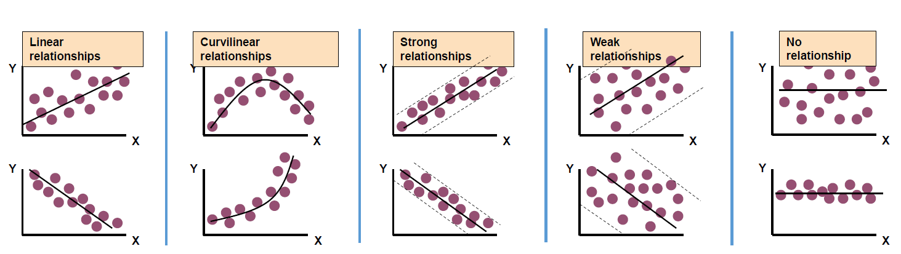
Types of Relationships

Slide 5
Type of Regression
Multiple Linear Regression
X1, X2, X3 --------> Y
Non-Linear Regression
X1, X2^2, X3^3 -----> Y
Simple Linear Regression
X ----------> Y

Slide 6
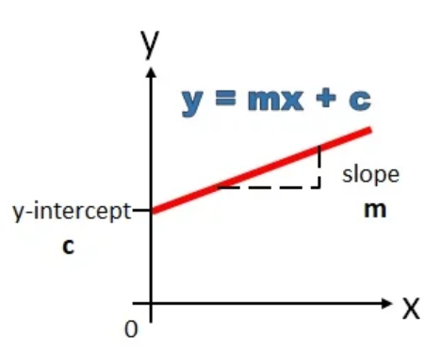
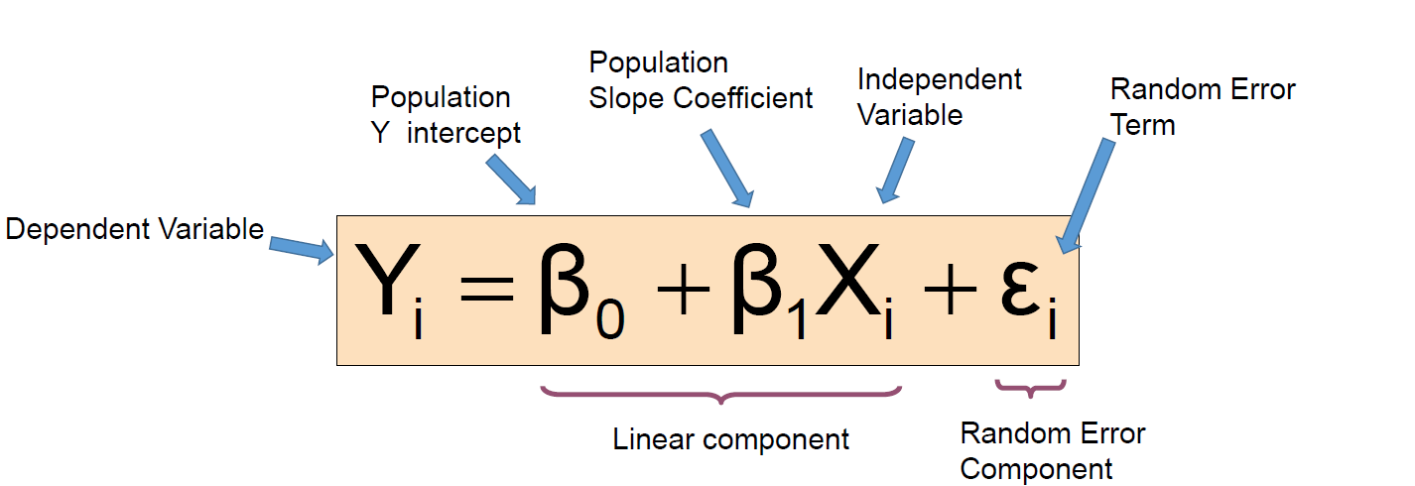
Simple Linear Regression
Establishes a linear relation between independent and dependent variables.
Attempts to model relationship between two variables by fitting a line called Linear Regression Line.
SLR has only one independent variable X.
Changes in Y are assumed to be related to changes in X.

Slide 7
Linear Regression Use Cases
Sales Forecasting
Risk Analysis
Housing Applications
Finance Applications
Weather Forecasting
Linear regression can be used in any scenario where we want to predict the outcomes based on given inputs.
The target variable is continuous in nature.

Slide 8
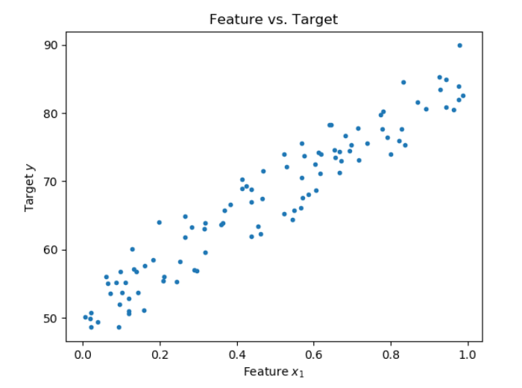
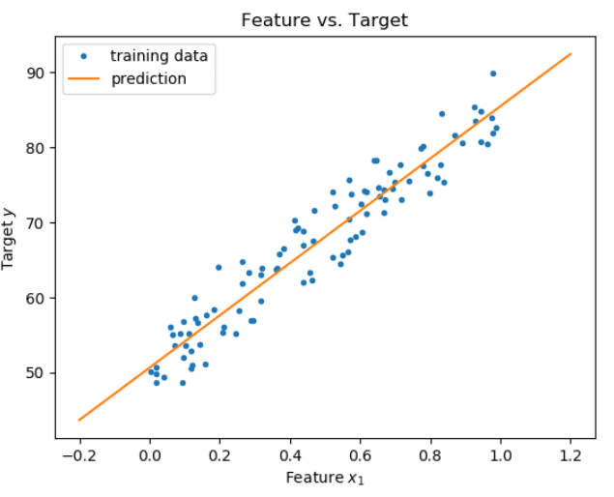
Finding the best fit line

Slide 9
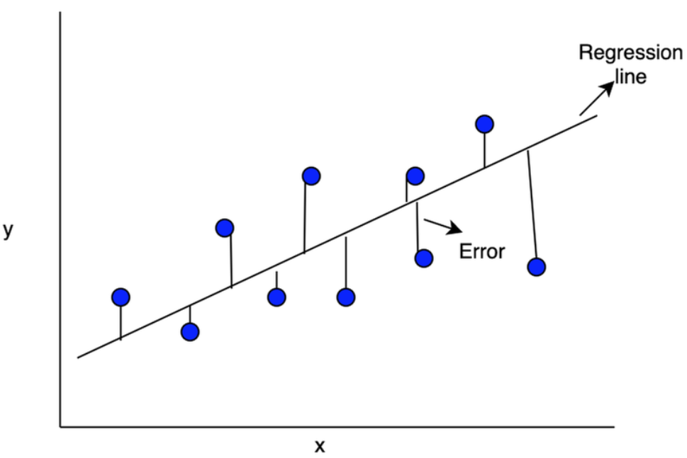
Finding the best fit line
The objective of line of best fit is that the predicted values should be as close as possible to the actual or observed values. This means the main objective in determining the line of best fit is to “minimize” the difference predicted values and observed values. These differences are called “errors” or “residuals”.

Slide 10
Ways to calculate the error
Sum of all errors: (∑(Y – f(X))) (This may result in the cancellation of positive and negative errors This will not be a correct metric to use).
Sum of absolute value of all errors: (∑|Y-f(X)|)
Sum of square of all errors (∑ (Y-f(X))^2)

Slide 11
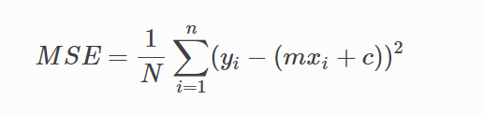
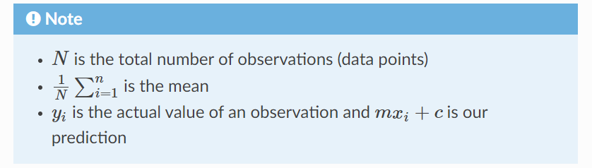
Cost Function
Y(SLR) = m*X + c + e
Y(MLR) = m1*X1 + m2*X2+ m3*X3… + e
Where “e” is error.
By achieving the best-fit regression line, the model aims to predict y value such that the error difference between predicted value and true value is minimum. So, it is very important to update the “m” and “c” values, to reach the best value that minimize the error between predicted y value (pred) and true y value (y).
MSE measures the average squared difference between an observation’s actual and predicted values

Slide 12
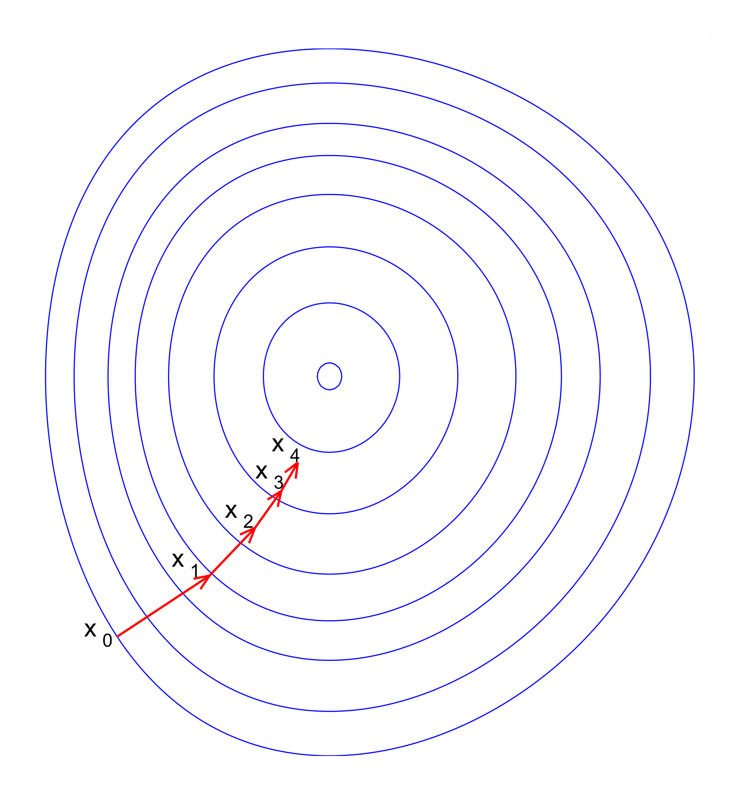
Gradient Descent
To update “m” and “c” values in order to reduce Cost function (minimizing RMSE value) and achieving the best fit line the model uses Gradient Descent. The idea is to start with random “m” and “c” values and then iteratively updating the values, reaching minimum cost.

Slide 13
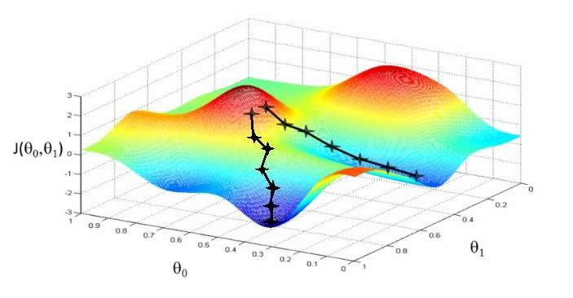
Gradient Descent
The process of minimizing the cost function can be achieved by Gradient Descent algorithm:
The steps are:
Start with initial guess of coefficients
Keep changing the coefficients a little bit to try
and reduce Cost Function J(θ₀,θ₁)
Each time, the parameters are changed, the gradient is chosen which reduces J(θ₀,θ₁) the most.
Repeat
Keep doing till no improvement is made.

Slide 14

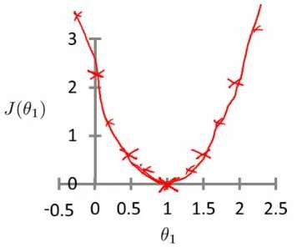
Inside Cost Function
Let's assume, θ₀ is 0. (Our hypothesis passes through origin)
So, now we need that value of θ₁ for which Cost function is minimum. To find that out, plot J(θ₁) vs θ₁

Slide 15
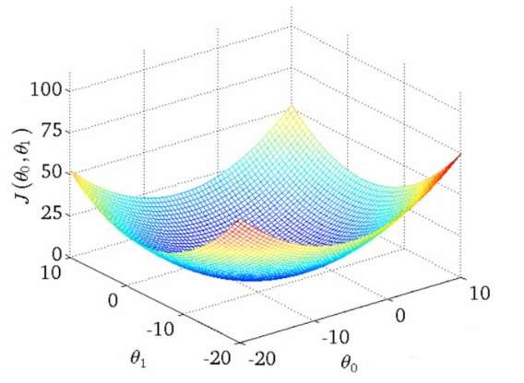
Inside Cost Function
With both θ₀ and θ_{1,} The plot becomes more complex
So, now we need that value of θ₁ for which Cost function is minimum. To find that out, plot J(θ_{1,} θ₀ ) vs θ₁ and θ₀

Slide 16
Sum of Squared Errors
Squaring the difference between actual value and predicted value “penalizes” more for each error. Hence minimizing the sum of squared errors improves the quality of regression line.
This method of fitting the data line so that there is minimal difference between the observations and the line is called the method of least squares.
Baseline model refers to the line which predicts each value as the average of the data points
SSE or Sum of Squared Errors is the total of all squares of the errors. It is a measure of the quality of regression line. SSE is sensitive to the number of input data points.

Slide 17
Regression Metrics
Mean Absolute Error: One way to measure error is by using absolute error to find the predicted distance from the true value. The mean absolute error takes the total absolute error of each example and averages the error based on the number of data points. By adding up all the absolute values of errors of a model we can avoid canceling out errors from being too high or below the true values and get an overall error metric to evaluate the model on.

Slide 18
Regression Metrics
Mean Squared Error: Mean squared is the most common metric to measure model performance. In contrast with absolute error, the residual error (the difference between predicted and the true value) is squared.
Some benefits of squaring the residual error is that error terms are positive, it emphasizes larger errors over smaller errors, and is differentiable. Being differentiable allows us to use calculus to find minimum or maximum values, often resulting in being more computationally efficient.

Slide 19

R-Squared
Coefficient of determination
It determines how much of the total variation in Y is explained by the variation in X.
Ranges from 0 to 1
A model with an R² of 0 is no better than a model that always predicts the mean of the target variable, whereas a model with an R of 1 perfectly predicts the target variable

Slide 20
Multivariable Regression
Let’s say we are given data on Phones, radio, and newspaper advertising spend for a list of companies, and our goal is to predict sales in terms of units sold.
Company | Phones | TV | News | Units
Amazon | 230.1 | 37.8 | 69.1 | 22.1
Google | 44.5 | 39.3 | 23.1 | 10.4
Facebook | 17.2 | 45.9 | 34.7 | 18.3
Apple | 151.5 | 41.3 | 13.2 | 18.5
Sales = W1*TV + W2*Radio + W3*Newspaper

Slide 21
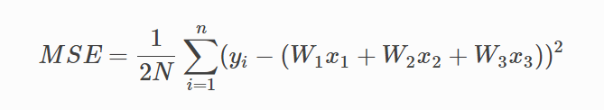
Cost Function Multivariable regression
Now we need a cost function to audit how our model is performing. The math is the same, except we swap the mx+b expression for W1x1+W2x2+W3x3. We also divide the expression by 2 to make derivative calculations simpler.

Slide 22
Demo(Python)

Slide 23
Advantages
Disadvantages
Linear Regression is simple to implement and easier to interpret the output coefficients.
Less complex compared to other models
When you know the relationship between the independent and dependent variable have a linear relationship, this algorithm is the best to use because of its less complexity to compared to other algorithms.
Linear Regression is susceptible to over fitting, but it can be avoided using some dimensionality reduction techniques, regularization (L1 and L2) techniques and cross-validation.
Outliers have huge effects on the regression.
Assumes linear relationship between the dependent and independent variables, even when they don’t have linear relationship.
Assumes that the predictor variables are independent of each other.

